Slide 1
Exploratory Data Analysis (EDA) on Healthcare Dataset
Project Overview and Key Findings
Presented By Kandukuri Jaswanth
Paramkusam Divya Teja

Slide 2
Introduction
This presentation covers the exploratory data analysis (EDA) conducted on a healthcare dataset. It includes data cleaning, visualization, and key insights for improving patient outcomes and operational efficiency.

Slide 3
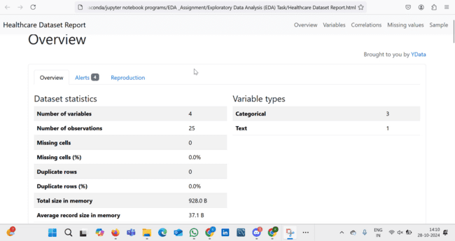
Healthcare Dataset Report

Slide 4
Dataset Overview
The healthcare dataset contains patient information, medical history, treatments, and outcomes. The data includes various fields like age, gender, diagnosis, treatment plans, and recovery rates.

Slide 5
Data Cleaning
The data was cleaned to remove missing values, handle outliers, and normalize certain fields. Techniques like imputation and scaling were applied to ensure accurate analysis.

Slide 6
Data Visualization
Various visualizations were created to explore relationships in the dataset, including histograms, scatter plots, and correlation matrices. These visualizations revealed trends in patient recovery times and the effectiveness of different treatments.

Slide 7
Key Findings
The EDA revealed the following key findings:
- Age and underlying conditions significantly affect recovery rates.
- Certain treatments show higher success rates for specific diagnoses.
- Gender differences were observed in treatment responses.

Slide 8
Conclusion
The exploratory data analysis provided valuable insights into patient outcomes and treatment effectiveness. These findings can guide healthcare providers in making informed decisions to improve patient care.

